Slide 1
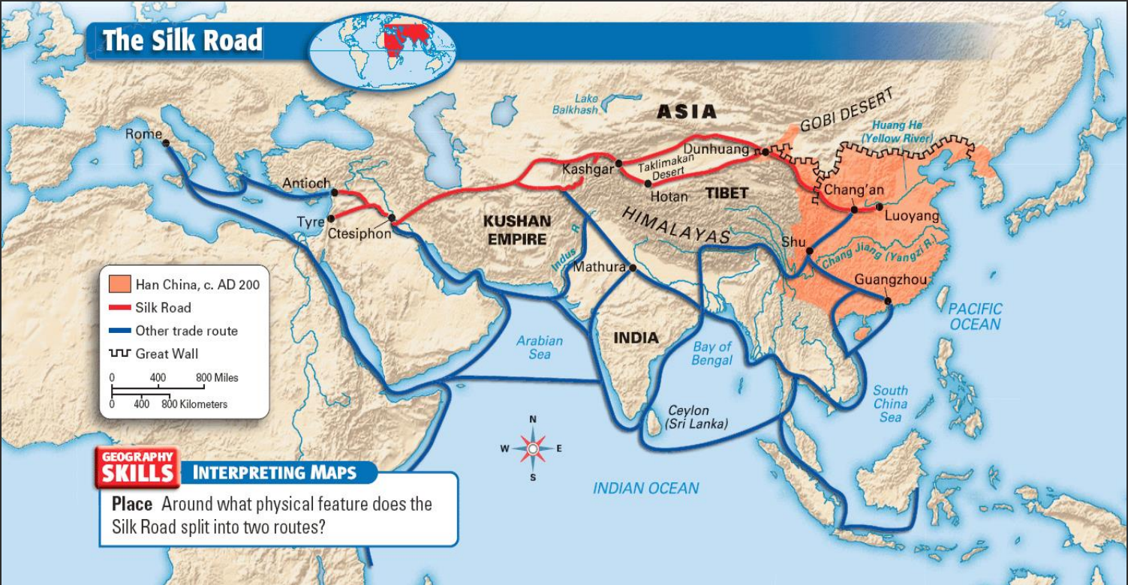
Schools of Philosophy and trade of the Chinese Civilization
Presented By
Joy Kumar Ghosh
2211424642
Department of Engineering and Computer Science
North South University

Slide 2
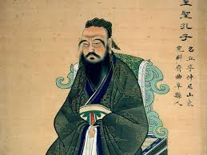
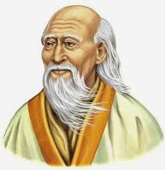
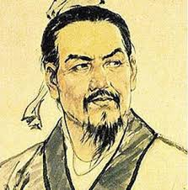
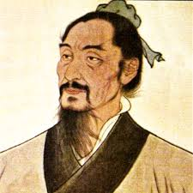
Schools of Philosophy
Confucianism: Emphasizes moral values, social harmony, and respect for authority.
Taoism: Focuses on living in harmony with nature, simplicity, and the concept of the Tao.
Legalism: Advocates for strict laws, strong central authority, and punishment for maintaining social order.
Mohism: Promotes universal love, impartiality, and the rejection of excessive material wealth.
School of Yin and Yang: Explores the concept of dualism and the interconnectedness of opposing forces.

Slide 3
Confucianism
Confucianism is the most important school of philosophy in Chinese history. It is based on the teachings of Confucius, who lived from 551 to 479 BCE. Confucianism emphasizes the importance of family, community, and social harmony. It also stresses the importance of education and personal development.
Key principles and teachings of Confucianism:
Emphasis on filial piety, respect for elders, and family values.
The importance of education and self-cultivation.
The concept of the "Five Relationships" and proper social conduct.
Influence on Chinese government, education, and social ethics.

Slide 4
Taoism
Taoism is another important school of philosophy in Chinese history. It is based on the teachings of Laozi, who lived from 604 to 531 BCE. Taoism emphasizes the importance of living in harmony with nature and following the natural way of things. It also stresses the importance of simplicity and contentment.
Main tenets and philosophy of Taoism:
The concept of the Tao as the underlying principle of the universe.
Embracing simplicity, spontaneity, and naturalness.
The pursuit of personal harmony and balance.
Influence on Chinese art, literature, and medicine.

Slide 5
Legalism
Legalism was founded by Han Fei, who lived from 280 to 233 BCE. Legalism is a school of philosophy that emphasizes the importance of law and order. Legalists believe that the best way to govern a country is to have a strong central government that enforces strict laws.
The core ideas of Legalism:
The need for strict laws, regulations, and punishment to maintain social order.
Emphasis on the power of the ruler and the centralization of authority.
Utilitarian approach to governance.
Influence on Chinese political systems and administrative practices.

Slide 6
Mohism
Mohism was founded by Mozi, who lived from 470 to 390 BCE. Mohism is a school of philosophy that emphasizes the importance of universal love and non-violence. Mohists believe that everyone should be treated equally, regardless of their social status or wealth. They also believe that the best way to achieve this is through non-violence.
The key principles of Mohism:
Universal love and impartiality towards all individuals.
The rejection of excessive material wealth and extravagant rituals.
Advocacy for a society based on mutual benefit and social harmony.
Influence on Chinese social and ethical values.

Slide 7
School of Yin and Yang
The School of Yin and Yang was founded by Zou Yan in the 4th century BCE. It is a school of thought that emphasizes the importance of balance and harmony in the universe. The school is based on the belief that everything in the universe is made up of two complementary forces: yin and yang. Yin is associated with darkness, cold, and femininity, while yang is associated with light, heat, and masculinity. The two forces are constantly in flux and balance each other out.
The philosophy of Yin and Yang:
The concept of opposing but interconnected forces in the universe.
Balance and harmony between Yin (passive, dark) and Yang (active, bright).
Application of Yin and Yang principles in various aspects of life.
Influence on Chinese cosmology, medicine, and philosophy.

Slide 8
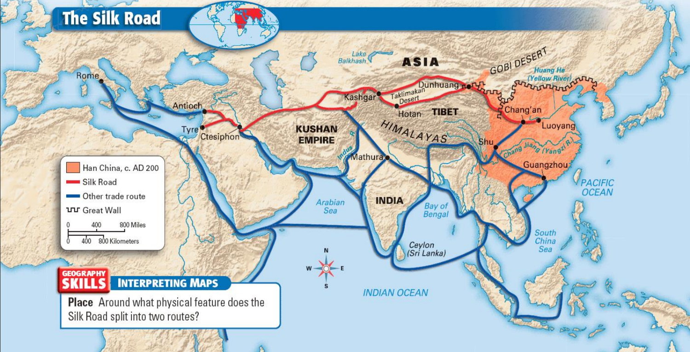
Trade of the Chinese Civilization

Slide 9
Trade Goods and Cultural Exchange
China has a long and rich history of trade. The Silk Road, which connected China to the West, was one of the most important trade routes in history. Along the Silk Road, Chinese merchants traded goods such as silk, spices, tea, and porcelain with merchants from other countries. This trade helped to spread Chinese culture and ideas to other parts of the world.
The importance of trade in ancient China:
Geographic advantages and the development of trade routes (Silk Road, Maritime Silk Road).
Trade goods such as silk, tea, porcelain, and spices.
Cultural exchange, including the spread of Chinese philosophy, art, and technology.
Economic prosperity and the growth of cities and urban centers.

Slide 10
Conclusion
In conclusion, the schools of philosophy and trade played vital roles in shaping Chinese civilization. The schools of philosophy, including Confucianism, Taoism, Legalism, Mohism, and the School of Yin and Yang, offered diverse perspectives on life, governance, and ethics. Meanwhile, trade routes like the Silk Road and the Maritime Silk Road fostered economic growth, cultural exchange, and global connectivity.
Through these philosophical ideas and trade networks, ancient China left an indelible mark on the world, influencing not only its own society but also the development of other civilizations.

Slide 11

